Slide 1
Open Media @ UGA
Callie Holmes
Digital Archivist, Walter J. Brown Media Archives
October 26, 2018

Slide 2
Overview
Introduction to BMA
AV Digitization at the Brown Media Archives
Strategies for Implementing Change
Future of Open Source at BMA

Slide 3
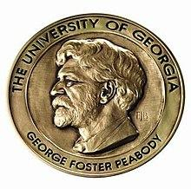
About BMA Collections
University of Georgia
Collections divided into 3 categories:
Newsfilm (6 Georgia stations)
Peabody Awards Collection
"Other" (home movies, UGA athletics, interview collections, folklore, town films, etc.)
250,000+ physical items (mostly video), over a petabyte of digital content
Notes:
BMA officially founded 1995 (though two of our major collections, WSB newsfilm and Peabody Awards Collection had been at university before)
UGA : just under 40,000 students
Collections
Newsfilm (6 stations, including WSB)
Peabody Awards Collection
Awards given to honor excellence in electronic media: radio, television, and online media -- basically anything not created solely for theatrical release
Includes all entries since 1940
"Other" collections (home movies, UGA Athletics, interview collections, religious broadcasting, town films)

Slide 4
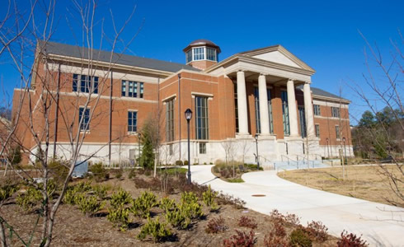
UGA Special Collections Library
Moved into new building in 2012
One of three departments in SCL
30,000 sq ft, high density storage vault
Notes:
Moved into building in 2012, lot of fundraising

Slide 5
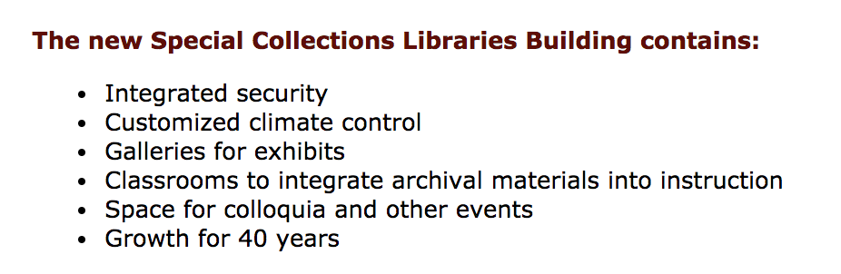
What's missing from this list?
(from a description of SCL building written around the time the building was opened in 2012)
Notes:
Great facility for teaching, great event space, excellent storage for physical materials, but no plan for digital preservation infrastructure
I think this actually happens surprisingly often with big projects at big institutions.

Slide 6
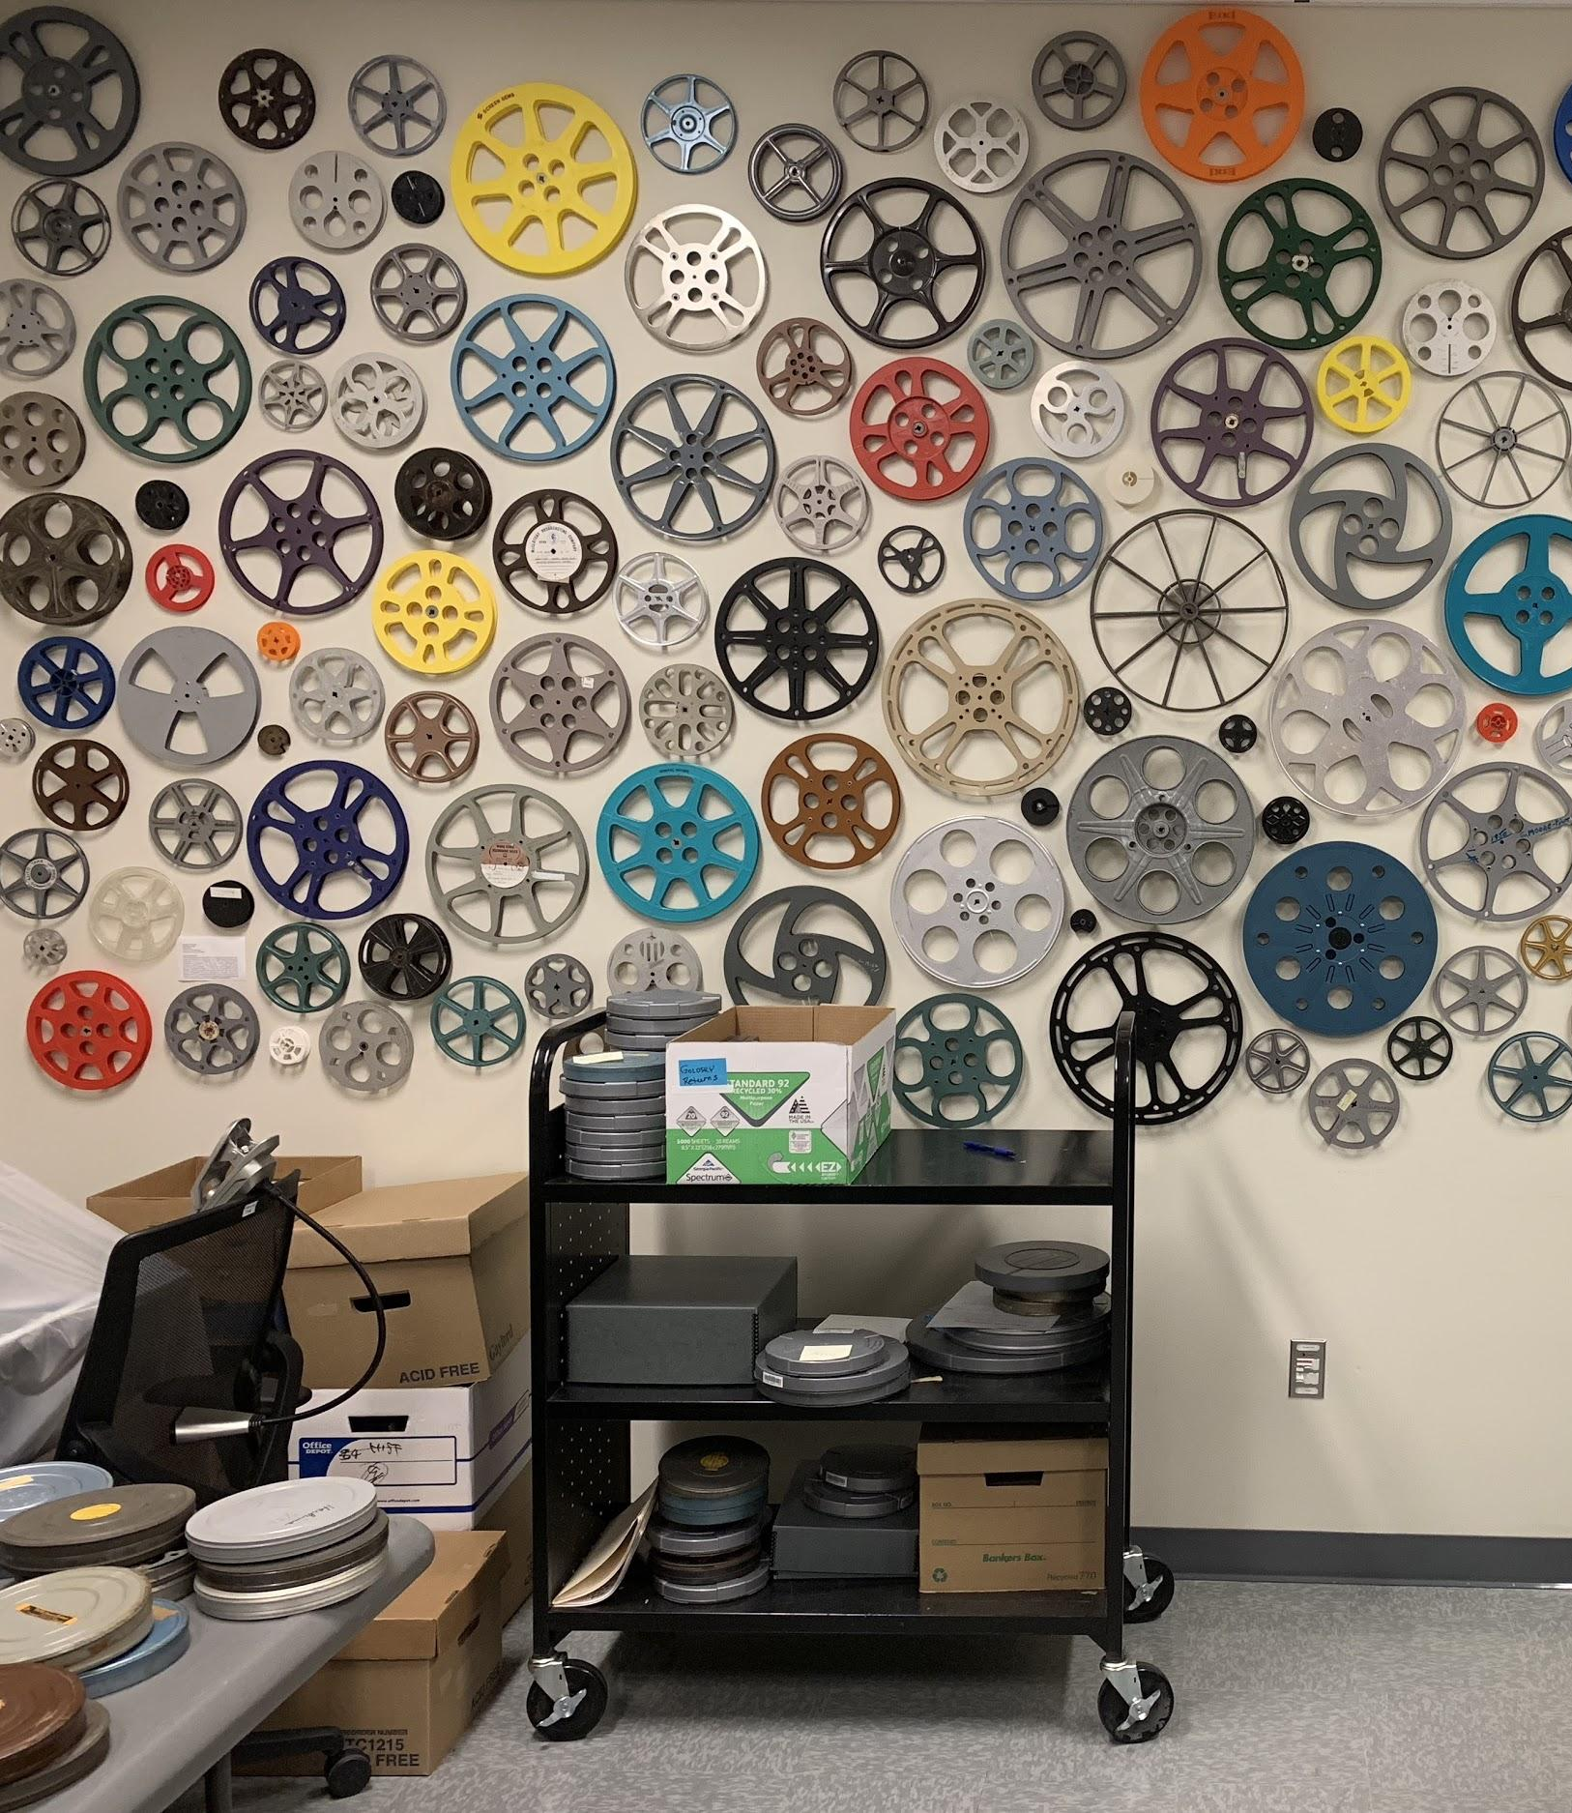
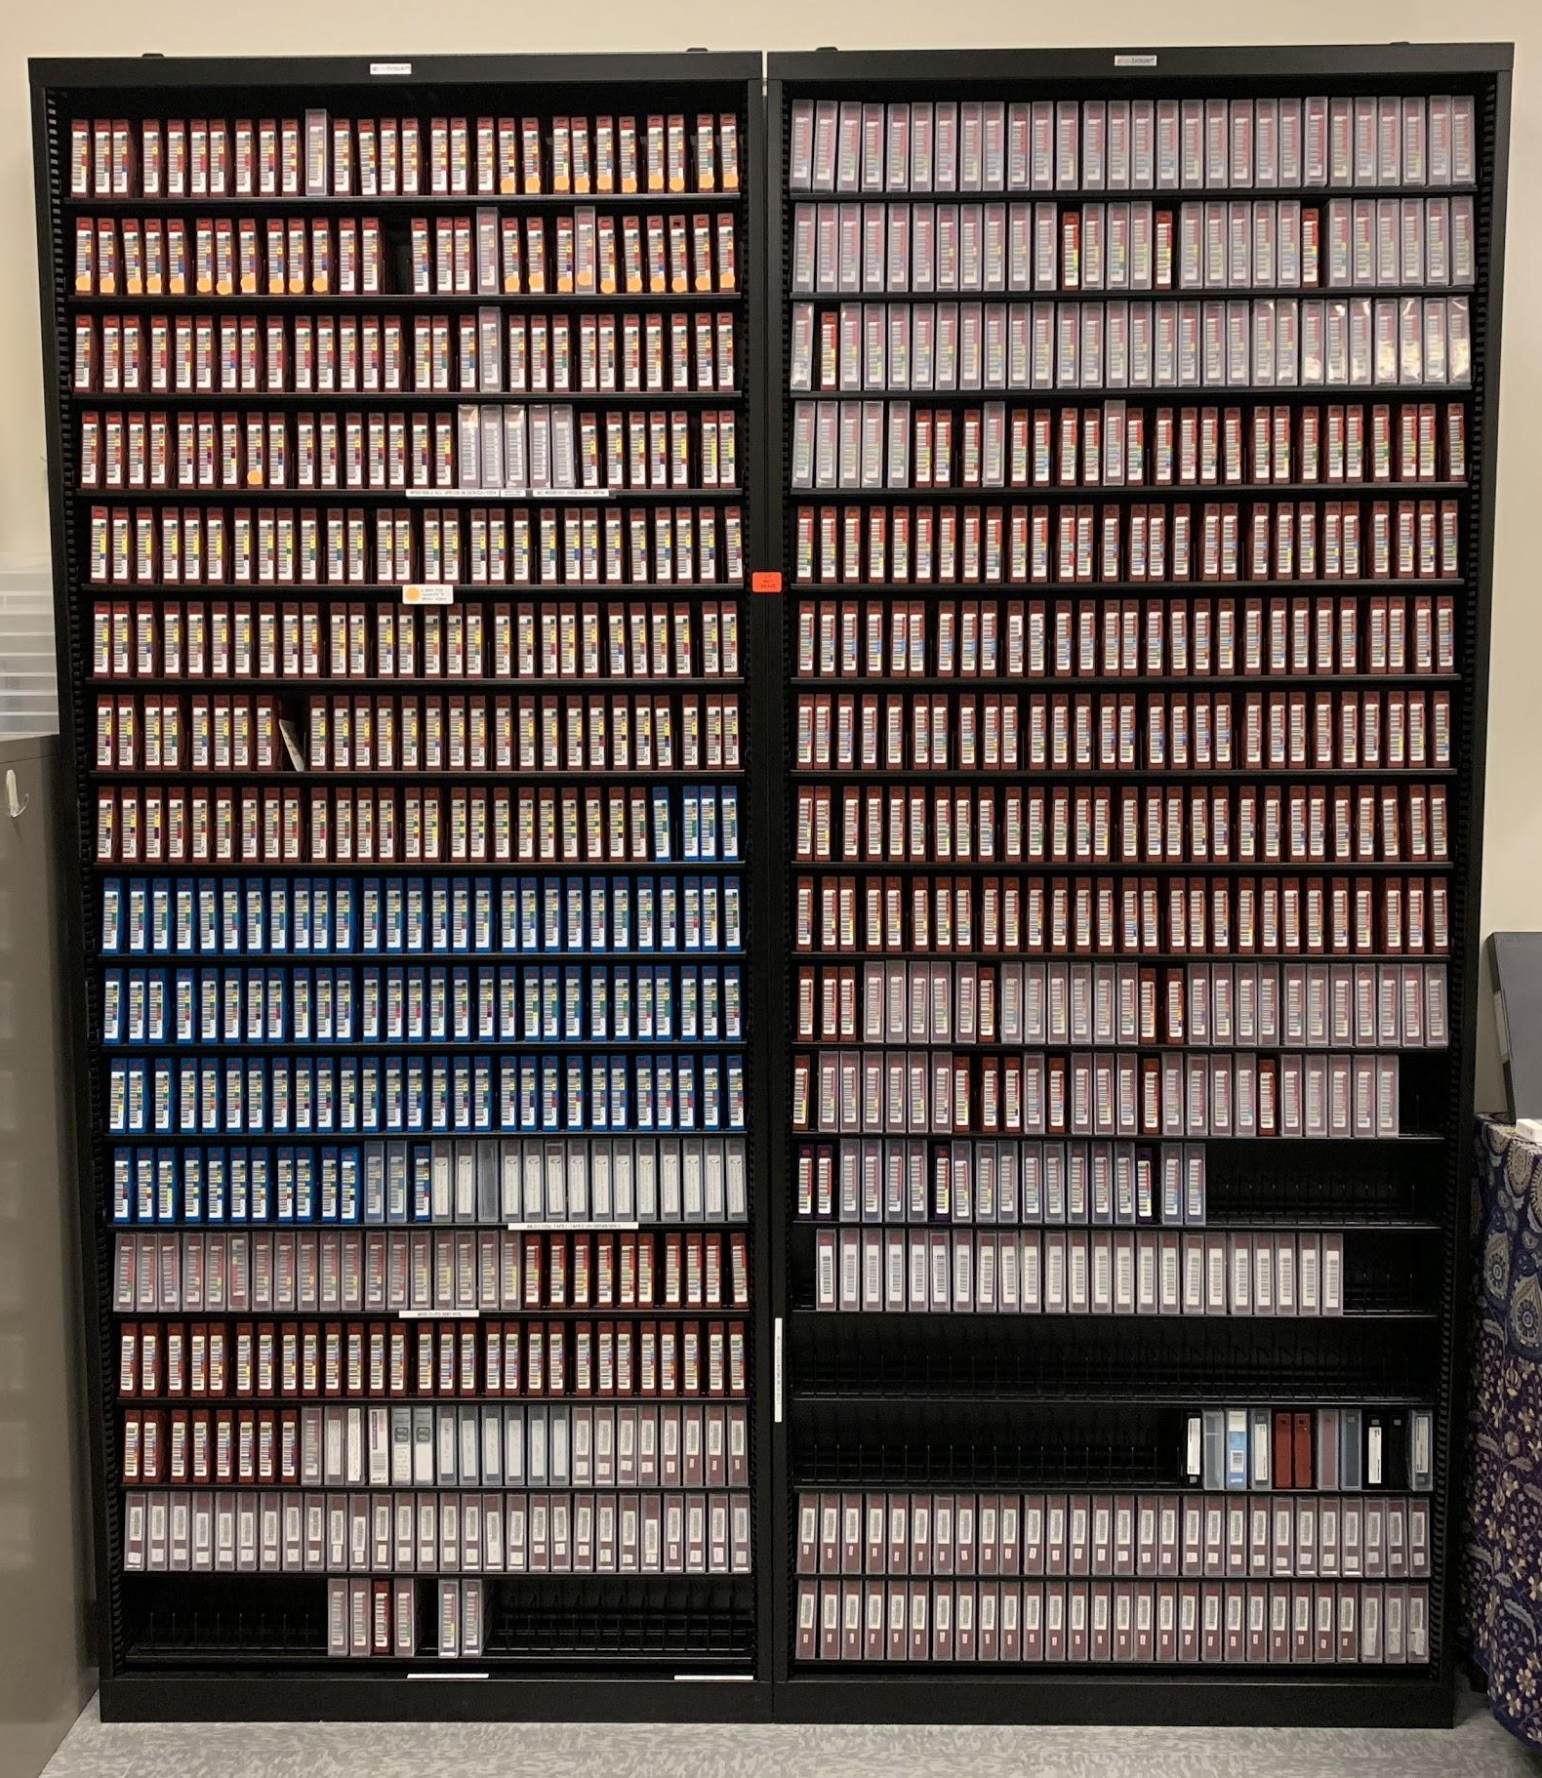
vs.
Notes:
On the left is a section of my colleague Margie's film reel wall. On the right is my Wall of LTO tapes. No one ever takes a picture in front of the LTO tapes. Digital is less attractive/appealing.

Slide 7
1.
History of AV Digitization at
Brown Media Archives
Notes:
When I set out to write a presentation about our shift towards more open media, I realized that I can't talk about the shift without talking about what we’re shifting from: What came before? What are our digital archives like? What did we used to do?
First time I really sort of sat down explicitly to gather this information, turned into sort of an oral history project
Crystallized for me how important people are to digital archives.
A central part of the history of our archives is a history of the people who've worked there.

Slide 8
3 Eras
The James Era (2007-2012)
Digitization begins, "industry" trends
The Alex Era (2012-2016)
Move towards open source
And Now (2016-present)
Notes:
There are 3 distinct eras of digitization corresponding to the 3 people who have “had this job” (although “this job” has changed a lot over the years)

Slide 9
Pre-historic (1995-2007)
Not much digitization for first ~10 years

Slide 10
The James Era (2007-2012)
Mid-2000s: two grants kick-started AV digitization
Civil Rights Digital Library (film)
Local TV in Peabody Awards Collection (¾-inch U-matic)
SAMMA machines: produced MXF-wrapped J2K files
Notes:
Digitization really became a big part of "what we do" in the mid-to-late 2000s, when we were awarded a couple of grants.
First: Civil Rights Digital Library which involved selecting CR-related clips from our newsfilm collections. Much of this work was outsourced.
Second: Followed shortly after and focused on local television programs from the Peabody Awards Collection (on ¾" U-matic tape).
Second grant is important because with this grant we purchased Samma machines.
Created MXF-wrapped J2K files.

Slide 11
The James Era (2007-2012) [cont.]
Only person "doing" digitization / digital preservation at BMA
Kept the in-house digitization going after grants
Video production background = v. aware of "industry trends"
Lot of MOV wrapped files
DV, shifted to ProRes
Mac computers (uncommon)
Final Cut Pro
Notes:
James used framework from grant to continue in-house digitization
Other than a rotating cast of students, James really did all of the “digital stuff”
Expertise he brought to the job was in video production
Direction followed "industry trends”
Cemented us a Mac shop
Final Cut Pro
Recognized the problems J2K caused for us and shifted to DV and then to ProRes

Slide 12
The Alex Era (2012-2016)
Shift to more open source solutions begins
Demand for collections increases
Still only one full time staff member
2015: First "Digital Archivist" hired
"Professional" vs. "Paraprofessional" in academic libraries in US
Scaling up infrastructure, automating processes
ffmpeg, mediainfo
automated scripting (bash and Python) for transcoding, checksums
Notes:
Characterized by increasing demand
When I talk about demand, in addition to students and academic researchers, many of our requests come from production companies: people making podcasts, documentaries. Particular kind of researcher.
Meeting that demand by scaling infrastructure and automating with scripting
Hired first Digital Archivist at beginning of 2015.
Brief aside: in US academic libraries, staff are typically divided between professional and para-professional.
Generally speaking, the “professional” staff have a graduate degree in library science or something similar, expected to contribute service to larger academic community, participate in professional conferences, paid more.
I’m tempted to roll my eyes at this division sometimes because, having been on the other side of the divide, I think it can cause unnecessary division in an organization and serve as a (perhaps unintentional) way of devaluing work
Here's what the hiring of the Digital Archivist signifies: UGA starting to take notice of the small mountain of digital files we’re creating and recognizing the need for a more holistic approach

Slide 13
The Alex Era (2012-2016) [cont.]
Purchased a film scanner
DPX files galore
Storage needs increase
Introduction of CollectiveAccess to manage analog and digital media
"open source" baggage
Notes:
Purchased a film scanner during this time period
Ability to create 2K film scans
DPX files galore, storage needs increase
CollectiveAccess
Open source content management system chosen so that we could have a system for managing our physical and digital collections together (away from spreadsheets…)
Alex was only able to get CA about 75% set up during his time at BMA, and even though I’ve been trying to finish that process for the past 2 years, none of us really feel like we understand it

Slide 14
A Fast Moving Train
Increasing Demand & Output
Requests for our collections have increased exponentially since 2012. Produce about 2 TB / week
Digital/LTO backlog
About a dozen LTO3 tapes, about 1000 LTO5 tapes (currently using LTO7)
Spotty Documentation
Undocumented (or minimally documented) workflows, policies, and procedures.
Folders with Files
Is X digitized? Do we have an HD version of that? Was this supposed to have audio?
Access
At least 5 totally different ways of providing access to digital content to end users
Other Duties as Assigned...
CollectiveAccess, supporting teaching mission of university, coordinating with Peabody Office, University committees, etc. etc.
Notes:
Increasing Demand/ Increased Output
Something like 400% more requests from 2012 to 2017
Output: creating about 2 TB/week of new digital files
Digital backlog: Some things still on LTO3, about 1000 LTO5 tapes
Currently using LTO7 machines
Older LTOs will need to be dealt with
Spotty Documentation
Collection information in various spreadsheets with **idiomatic/quirky standards
Chain connecting players and machines
What specifications were used? What programs?
Black box / Grab bag of files
Surprising how hard it is to answer “Has X been digitized?”
“What are these flash files?”
Access
This takes up a lot of my time.
At least 5 different systems
Complexity due to rights issues (Peabody = very rights restricted)
CollectiveAccess
Other Duties as assigned
Things competing for my attention
TRAC assessment, Faculty Advisory Board, approving timecards, burning DVDs for donors, trying to get central UGA IT to approve our forward facing Collective Access site, etc. etc.

Slide 15
Two Conflicting Realities
Truth #1
We need better workflows, better tools, better infrastructure: a more manageable system.
Truth #2
It is hard to find the time to make these changes when feeling overwhelmed by the existing flow of work.
Notes:
We need a more manageable system: better tools, better workflows, better policies
It is very difficult to find the time to plan and develop these kinds of systems when feeling overwhelmed by the current flow of work.

Slide 16
Strategies for
[Attempting to Maybe Try and Figure Out How To Go About]
Implementing Change
Notes:
In this next section, I’m going to go over some of the strategies I’ve found useful for advocating for and implementing changes

Slide 17
Strategy #1: Find a community
Digital Curation Working Group: charged with developing policies for ARCHive digital preservation system
Evolved into lib-learn-tech group at UGA Libraries
"Community of Practice"
XSLT, bash scripting, Python
Getting UGA Libs IT/Systems involved
Unifying workflows across departments
Notes:
I came to UGA from the Library of Congress Packard Campus for Audiovisual Conservation, so I went from being a surrounded by people who knew everything about all aspects of AV digitization to being The Expert. Felt like I didn’t have anyone to turn to.
Found a local community while working toward a solution to a problem I mentioned early in my presentation: the lack of any digital preservation infrastructure
Colleagues from across the UGA Libs ecosystem were charged to be part of a Digital Curation Working group responsible for developing policies and planning for what is now our ARCHive digital preservation system.
Found colleagues who may not do exactly what I do, but it’s similar.
Out of this, formed “lib learn tech” listserv and group
Community of Practice: "people who engage in a process of collective learning in a shared domain of human endeavor"
Work on learning new technologies, sharing skills
Gotten Libs IT/Systems involved, for example, with teaching some “how to with python” classes
Helped standardize workflows across departments

Slide 18
Strategy #2: Internal Outsourcing
Asking coworkers who aren't necessarily even in your department to help you with things
Difficult to let go of sweet lil' nugget problems
Examples:
XSL style sheets, Python-izing AIP-prep scripts, renaming PDFs, batch ffmpeg conversions
Notes:
Related to number 1, in that I’ve found coworkers, not necessarily in my department or even in m building, who I can turn to for help with problems.
Hard for two reasons
Asking for help
Letting go of those sweet little nugget problems that you know would be so satisfying to solve if you had time
Help with XSLT stylesheets, help renaming PDFs, help transcoding thousands of files
In that case he had the server power and storage space and an interest in video, I supplied the “expertise” (ffmpeg command)

Slide 19
Strategy #3: Challenge = Opportunity
DPX files (does anyone like these?)
Difficulties getting files on/off of LTO
False positive with virus-scanning software
Malformed bags
J2K files from SAMMA
All the more reason to shift to MKV/FFV1
"It is broken. We should definitely fix it."
Notes:
Not corporate speak
Earlier I mentioned some files and said they’d show back up later, and here they are.
We’ve been creating a lot of DPX files, and they are a headache.
Problems getting these files on and off of LTO tapes
Problems with malformed bag manifests
Situation where the open source virus scanning software was flagging random DPX files as an obscure virus.

Slide 20
Strategy #4: Seize the Moment
NHPRC grant to preserve 4000 hours of public broadcasting content from Peabody Awards Collection to become part of AAPB (American Archive of Public Broadcasting)
Benefits of Bureaucracy
Putting the grant out for open bidding = opportunity to redo technical specifications for deliverables

Slide 21
Strategy #5: Lean on Yall
Ruthlessly steal other people's workflows/specs
AMIA Open Source
ffmpeg: Thank you ffmprovisr!
Everyone in this room who writes blog posts, puts their workflow online, pushes scripts to github, responds to my Twitter Qs: Thank you!

Slide 22
1.
Moments yet to be Seized
Open Source plans for the future

Slide 23
Become the Tipping Point
FFV1 / MKV for for film scans: RAWcooked
Using MKV chapter feature for newsfilm?
MediaConch
Figure out how to give $ support to open source projects

Slide 24
Callie Holmes
Walter J. Brown Media Archives
University of Georgia
@cally__ho
ceholmes@uga.edu

